Slide 1
PROBLEM SOLVING USING C

Slide 2
Course Objectives
To understand the Fundamentals of Computers and introduction to C language.
To study the basic terminologies of C language and arrays
To understand the Functions, Structures and Unions.
To understand the concepts of Pointers.
To study about File Management Operations in C.

Slide 3
Course Outcomes
After completion of the course, the students will be able to
CO1 – Develop simple applications in C using basic constructs.
CO2 – Incorporating the use of sequential, selection and repetition control structures into a
program.
CO3 – Develop simple programs using functions, structures and unions.
CO4 – Design and develop programs using Pointers.
CO5 – Understand the File management Operations and Pre-processor Directives.

Slide 4
Syllabus
UNIT- I INTRODUCTION TO C
Fundamentals of Computer : Computer Definition – Block Diagram of Computer – Types of Computer –Characteristics of Computer – Applications of Computer. C programming: Overview of C – Constants –Compiling a C Program - Variables and Data Types-Technical Difference between Keywords and Identifiers -Types of C Qualifiers and format specifies - Operators and Expressions-Operators Precedence-Type conversion Input-Output Statements.
UNIT- II DECISION MAKING
Decision making and branching - Relational operators – Logical operators – if – if else-if else if – nested if, Switch case.
UNIT- III LOOPING AND ARRAYS
while - do while – for – break – continue - nested loop. Arrays: One Dimensional Arrays-Two Dimensional Arrays-Multi-Dimensional Arrays-Dynamic arrays-Character Arrays and Strings-Sorting – Searching.

Slide 5
UNIT -IV FUNCTIONS, POINTERS
Functions: Introduction - Definition – Declaration – Categories of Functions - Nesting of Functions, Recursive functions - Passing Arrays to Functions - Strings – String library function. Pointers: Introduction - Declaring Pointer Variables - Initialization of Pointer Variables - Accessing the address of a variable - Accessing a variable thorough Pointer - Chain of Pointers - Pointer Expressions - Pointers and arrays – Pointers and functions – Call by Reference - Pointers and character strings - Array of Pointers - Pointers and Structures.
UNIT- V STRUCTURES AND UNIONS, FILE MANAGEMENT
User defined data types: Introduction – Structure: definition - declaration - Arrays of Structures – Nested structures –Passing structures to functions – Union - Enumeration and Typedef. Introduction to File Handling in C, Input and Output operations on a file – Error Handling - Random access to files – command line arguments.

Slide 6
Introduction to C
Fundamentals Of Computer
DEFINITION OF COMPUTER :
A computer is an electronic device which takes input from the user, processes it and gives the output as per user’s requirement.
So the main tasks of performed by the computer are:
Input
Process
Output
DATA
PROCESS
INFORMATION

Slide 7
Task Performed by Computer are:
Input (Data):
Input is the raw information entered into a computer from the input devices. It is the collection of letters, numbers, images etc.
Process:
Process is the operation of data as per given instruction. It is totally internal process of the computer system.
Output:
Output is the processed data given by computer after data processing. Output is also called as Result. We can save these results in the storage devices for the future use.

Slide 8
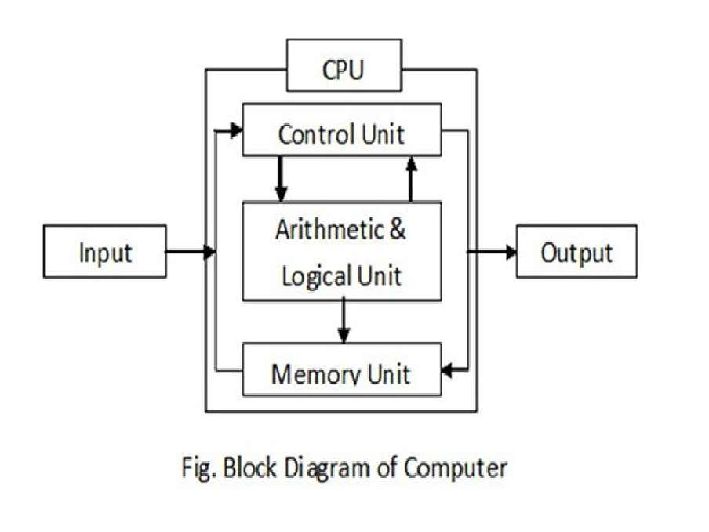
Block Diagram Of Computer

Slide 9


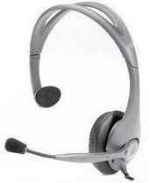
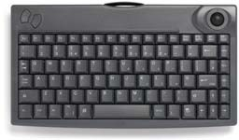
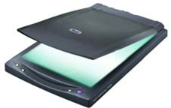
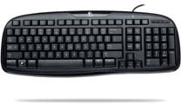


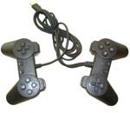
Input Unit
Mouse
Microphone
Track Ball
Key Board
Scanner
Web Camera
Light Pen
Joy Stick

Slide 10
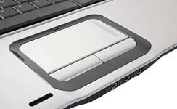
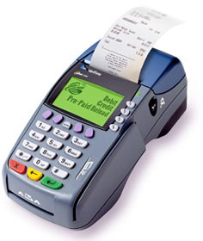
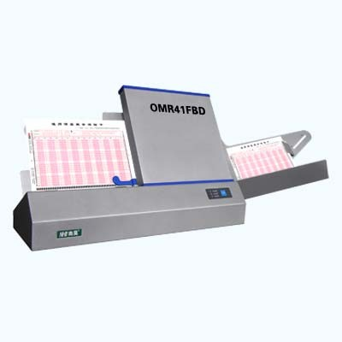
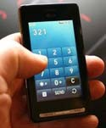
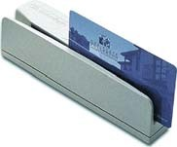

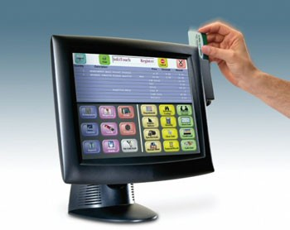
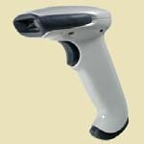

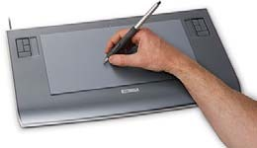
Optical Mark Reader used for Answer sheet making purpose
Touch Pad or Screen
Bar Code Reader
Magnetic Card Reader Used in Shop Colleges and Stations etc
Magnetic Ink Reader(Used in Bank)
Graphics Tablets

Slide 11
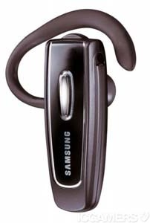
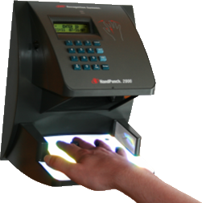
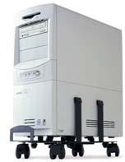
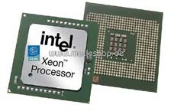
Blue Tooth
Bio Metric Devices
Central Processing Unit :
CPU (Central Processing Unit) CPU is considered as the brain of the computer. CPU performs all types of data processing operations. It stores data, intermediate results, and instructions (program). It controls the operation of all parts of the computer. CPU itself has the following three components: • ALU (Arithmetic Logic Unit) • Memory Unit • Control Uni

Slide 12
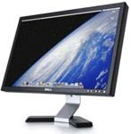
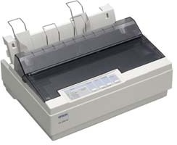
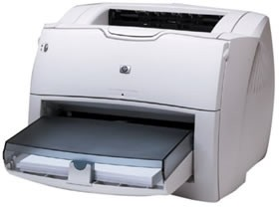
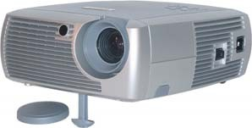
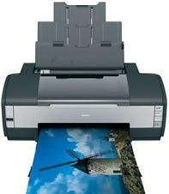
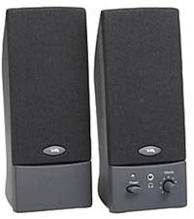
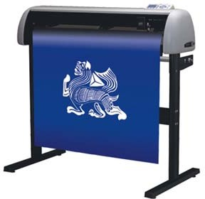
Output Unit
Monitor
Printer(Dot Matrix)
Laser Printer
Projector
Speakers
Ink Jet Printer
Plotter

Slide 13
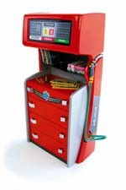
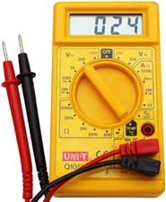

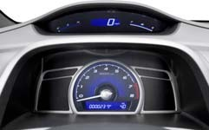
Types Of Computer
On the basis of working principle
Analog Computer
An analog computer (spelt analogue in British English) is a form of computer that uses continuous physical phenomena such as electrical, mechanical, or hydraulic quantities to model the problem being solved.
Petrol Pump Indicator
Thermometer
Multimeter
Speedometer

Slide 14

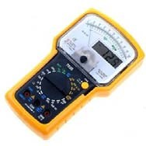
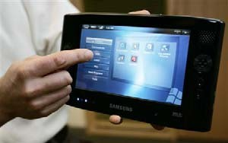
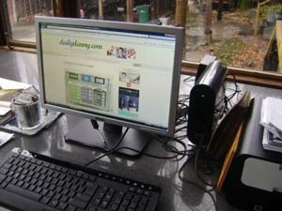
Digital Computer
A computer that performs calculations and logical operations with quantities represented as digits, usually in the binary number system.
Hybrid Computer (Analog + Digital)
A combination of computers those are capable of inputting and outputting in both digital and analog signals.
A hybrid computer system setup offers a cost effective method of performing complex simulations.

Slide 15
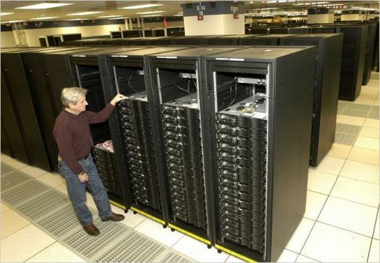
On the basis of Size
Super Computer
The fastest type of computer. Supercomputers are very expensive and are employed for specialized applications that require immense amounts of mathematical calculations. For example, weather forecasting requires a supercomputer. Other uses of supercomputers include animated graphics, fluid dynamic calculations, nuclear energy research, and petroleum exploration.
The chief difference between a supercomputer and a mainframe is that a supercomputer channels all its power into executing a few programs as fast as possible, whereas a mainframe uses its power to execute many programs concurrently

Slide 16
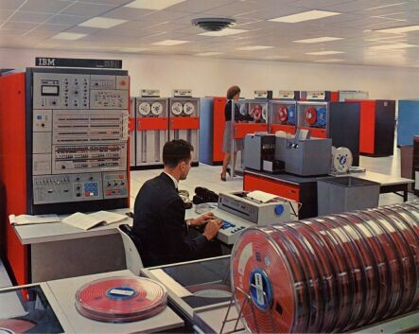
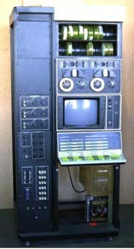
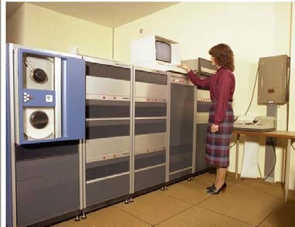
Mainframe Computer
A very large and expensive computer capable of supporting hundreds, or even thousands, of users simultaneously. In the hierarchy that starts with a simple microprocessor (in watches, for example) at the bottom and moves to supercomputers at the top, mainframes are just below supercomputers. In some ways, mainframes are more powerful than supercomputers because they support more simultaneous programs. But supercomputers can execute a single program faster than a mainframe
Mini Computer
A midsized computer. In size and power, minicomputers lie between workstations and mainframes. In the past decade, the distinction between large minicomputers and small mainframes has blurred, however, as has the distinction between small minicomputers and workstations. But in general, a minicomputer is a multiprocessing system capable of supporting from 4 to about 200 users simultaneously

Slide 17
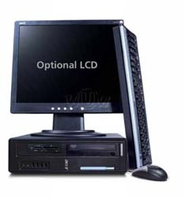
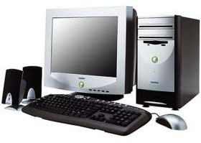
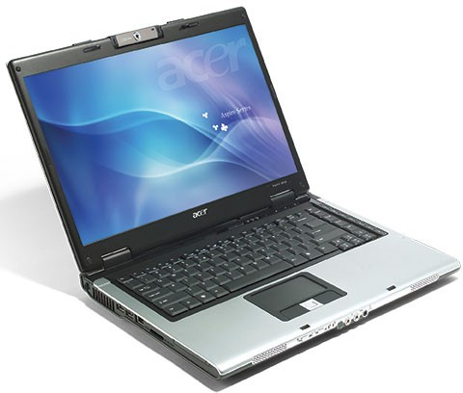
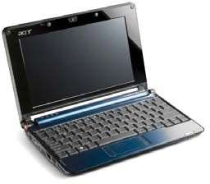
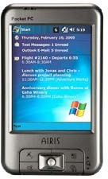
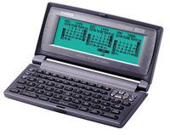
Micro Computer
Desktop Computer: a personal or micro-mini computer sufficient to fit on a desk
  Laptop Computer : a portable computer complete with an integrated screen
and keyboard. It is generally smaller in size than a desktop computer and larger than a notebook computer
  Palmtop Computer/Digital Diary /Notebook /PDAs: a hand-sized computer. Palmtops have no keyboard but the screen serves both as an input and output device.

Slide 18
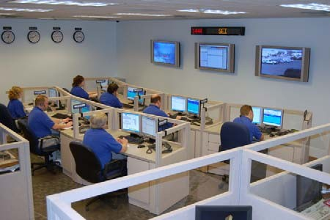
Workstations
A terminal or desktop computer in a network. In this context, workstation is just a generic term for a user's machine (client machine) in contrast to a "server" or "mainframe
CHARACTERISTICS OF COMPUTERS
The major characteristics of computer can be classified in to speed, accuracy, diligence, versatility and memory which are as follows:
Speed :
The computer is able to process the date and give the output in fractions of seconds such that required information is given to the user on time enabling the user to take right decisions on right time. A powerful computer is capable of executing about 3 million calculations per second.

Slide 19
Accuracy :
Inspire of its high speed of processing, the computers accuracy is consistently high enough which avoids any errors. If it all there are errors, they are due to errors in instructions given by the programmer.
Reliable :
The output generated by the computer is very reliable, but it is reliable only when the data, which is passing as input to the computer and the program, which gives instructions are correct and reliable.
Storage Capacity :
The computer has a provision to store large volumes of data in the small storage devices, which have capacity to store huge amounts of data and help the retrieval of data an easy task.
Versatile :
The computer perform three basic operations • It is capable to access and accept information through various input-output devices from the user. • It performs basic Arithmetic and Logic operations on data as desired. • It is capable to generate the desired output in the desired form.
Automation :
Once the instructions fed into computer it works automatically without any human intervention until the completion of execution of program until meets logical instructions to terminate the job.

Slide 20
Applications Of Computer
Computers play a role in every field of life. They are used in the following fields :
Homes
Business
Educational institutions
Research organizations
Medical field
Government offices
Entertainment
etc.

Slide 21
Overview Of C
C is a general-purpose, high-level language that was originally developed by Dennis M. Ritchie to develop the UNIX operating system at Bell Labs in 1972.
C has now become a widely used professional language for various reasons:
Programs written in C are Efficient and Fast.
C is highly portable.
Another important feature of C is its ability to extend itself.
It is well suited for system software and business packages.
It is well suited for Structured Programming.
We can add our own functions to C Library.

Slide 22
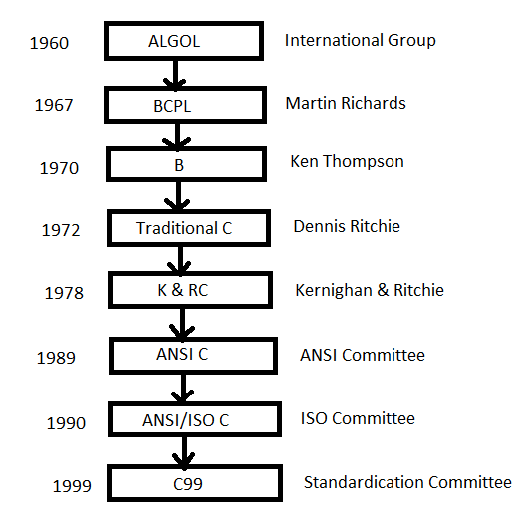
History of ANSI C

Slide 23
BASIC STRUCTURE OF C LANGUAGE
The program written in C language follows this basic structure. The sequence of sections
should be as they are in the basic structure. A C program should have one or more sections but the sequence
of sections is to be followed.
1. Documentation section
2. Linking section
3. Definition section
4. Global declaration section
5. Main function section
{
Declaration section
Executable section
}
6. Sub program or function section

Slide 24
1. DOCUMENTATION SECTION : comes first and is used to document the use of logic or reasons
in your program. It can be used to write the program's objective, developer and logic details.
The documentation is done in C language with /* and */ . Whatever is written between
these two are called comments.
2. LINKING SECTION : This section tells the compiler to link the certain occurrences of keywords
or functions in your program to the header files specified in this section.
e.g. #include <stdio.h>
3. DEFINITION SECTION : It is used to declare some constants and assign them some value.
e.g. #define MAX 25
Here #define is a compiler directive which tells the compiler whenever MAX is found in
the program replace it with 25.
4. GLOBAL DECLARATION SECTION : Here the variables which are used through out the
program (including main and other functions) are declared so as to make them global(i.e
accessible to all parts of program)
e.g. int i; (before main())

Slide 25
5. MAIN FUNCTION SECTION : It tells the compiler where to start the execution from
main()
{
point from execution starts
}
main function has two sections
1. declaration section : In this the variables and their data types are declared.
2. Executable section : This has the part of program which actually performs the task we
need.
6. SUB PROGRAM OR FUNCTION SECTION : This has all the sub programs or the functions
which our program needs.
SIMPLE ‘C’ PROGRAM:
/* simple program in c */
#include<stdio.h>
main()
{
printf(“welcome to c programming”);
} /* End of main */

Slide 26
C-TOKENS :
Tokens are individual words and punctuations marks in English language sentence. The smallest individual
units are known as C tokens.
OPERATORS E.g. +, -, *
SPECIAL SYMBOLS E.g. [ ], { }
STRINGS E.g. “Welcome”
CONSTANTS E.g. -15.4, ‘a’, 200
IDENTIFIERS E.g. rate,no_of_hours
KEY WORDS E.g. int, printf

Slide 27
Declaring Constants
There are two ways of defining constants in C: using #define and const.
#define is a compiler preprocessor which replaces each occurrence of the constant's name with its value:
The general form of the constant declaration is:
#define ConstantName ConstantValue
Let's take a look at a few examples:
#define withholding_rate 0.8
#define prompt 'y'
#define answer "yes"
#define maxpeople 15
#define inchperft 12
#define speed_limit 55

Slide 28
Declaring Constants
The general form of the constant declaration is:
const datatype ConstantName = ConstantValue,
AnotherConstantName =
AnotherConstantValue;
Let's take a look at a few examples of constants:
const float withholding_rate = 0.8;
const char prompt = ‘y‘,
answer[] = “yes”;
const int maxpeople = 15,
inchperft = 12;
speed_limit = 55;

Slide 29
Variables and Identifiers
Variables have names – we call these names identifiers.
An identifier must begin with a letter or an underscore _
C is case sensitive upper case (capital) or lower case letters are considered different characters. Average, average and AVERAGE are three different identifiers.
Numbers can also appear after the first character.
However, C only considers the first 31 (external identifiers) or first 63 (internal identifiers) significant.
Identifiers cannot be reserved words (special words like int, main, etc.)

Slide 30
Keywords Identifiers
Keywords are predefined word that gets reserved for working program that have special meaning and cannot get used anywhere else.
Specify the type/kind of entity.
It always starts with a lowercase letter.
A keyword should be in lower case.
Identifiers are the values used to define different programming items such as variables, integers, structures, unions and others and mostly have an alphabetic character
Identify the name of a particular entity.
First character can be a uppercase, lowercase letter or underscore.
An identifier can be in upper case or lower case.

Slide 31
Keywords
Identifiers
A keyword contains only alphabetical characters.
They help to identify a specific property that exists within a computer language.
No special symbol, punctuation is used.
Examples of keywords are: int, char, if, while, do, class etc.
An identifier can consist of alphabetical characters, digits and underscores.
They help to locate the name of the entity that gets defined along with a keyword.
No punctuation or special symbol except ‘underscore’ is used.
Examples of identifiers are: Test, count1, high_speed, etc.

Slide 32
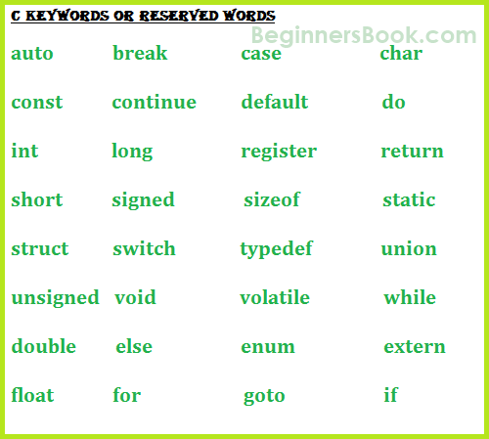
C Keywords or Reserved words

